Slide 1
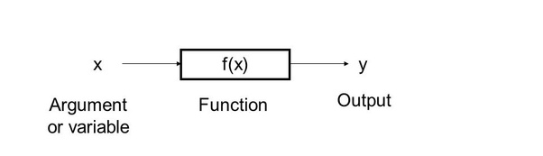
WHAT ARE FUNCTIONS?
Section of a program that performs a specific task
for e.g. covert number to binary 7 -> -> 111, print a string, maximum of a list, etc.
DEC to BIN

Slide 2
WHAT ARE FUNCTIONS?
Solution to given programming problem can be thought of in terms of functions needed. Functional Programing.
A library has collection of related functions. e.g. Math library has Mathematical functions.

Slide 3
Functions in Python
def functionname( parameters ):
"function_docstring"
function_suite
return [expression]

Slide 4
Built-in Functions
abs()
all()
any()
print()
id()
type()

Slide 5
Argument passing
Required arguments
def printme( str ):
"This prints a passed string into this function"
print (str)
return
printme(“My String”)
Keyword arguments
def printme( str ):
"This prints a passed string into this function"
print (str)
return
printme( str = "My string")

Slide 6
Argument passing
Default arguments
def printinfo( name, age=“35” ):
"This prints a passed info into this function"
print ("Name: ", name)
print ("Age ", age)
return
printinfo( name = "miki” )

Slide 7
Argument passing
Variable arguments
def printinfo( arg1, *vartuple ):
"This prints a variable passed arguments"
print ("Output is: ")
print (arg1)
for var in vartuple:
print (var)
return
# Now you can call printinfo function
printinfo( 10 )
printinfo( 70, 60, 50 )

Slide 8
Use Cases
(n,k) -> -> C(n,k)
e.g. (4,2) -> -> 6
(point1,point2,point3) -> -> area by heron’s
e.g. ((0,0),(3,0),(2,4)) -> -> 6
COMBINATORIAL
AREA OF TRIANGLE

Slide 9
Pass by reference and Pass by value
Python uses pass by reference
Value of id() same for calling env and called function
If you modify the object within a function, the change also reflects back in the calling env.
modification is possible for list, set, etc.

Slide 10
Pass by reference and Pass by value
Called function
def func1(arg1, arg2, ….)
……..
……..
………..
………..
func1(x, y, ….)
Formal arguments
Calling environment
Actual arguments

Slide 11
Pass by reference
def func1(arg1, arg2, ….)
……..
……..
………..
………..
func1(x, y, ….)
memory

Slide 12
Pass by reference - immutable
def func1(arg1, arg2, ….)
……..
……..
………..
………..
func1(x, y, ….)
reassignment
memory_2
memory

Slide 13
Pass by reference - mutable
def func1(arg1, arg2, ….)
……..
……..
………..
………..
func1(x, y, ….)
change
reassignment
memory_2
memory

